Slide 1

Supervised machine learning for NLP
Sumithra Velupillai
Acknowledgements to Genevieve Gorrell, University of Sheffield

Slide 2
What we will cover
Introduction to supervised machine learning in the context of NLP
Basic concepts
Common algorithms
We will NOT discuss all algorithms and underlying theories in detail
Common tasks
Development cycle

Slide 3
Supervised machine learning
Supervised ML algorithms
learn to map an output variable given some input data
Supervised
the algorithm learns from existing output variables/labels
iteratively makes predictions
corrected according to some criteria until no improvements

Slide 4
Supervised vs unsupervised learning
Recap: unsupervised learning means that you don’t have any given output variables
Instead, the algorithm models the underlying structure or distribution according to some criteria

Slide 5
Supervised learning vs. pattern matching rules
Humans are good at writing rules
But: time-consuming
ML approaches learn automatically
But: you need labelled data!
Rule-based approaches can be useful as features in ML

Slide 6
Classification tasks in NLP
Sentiment
Spam
Document category
Language
Phenotypes
Patient status
Entities
…

Slide 7
Terminology
Instances
Attributes, or features
Classes, or labels

Slide 8
Instances
Cases that can be learned
Every instance is mapped to an output variable

Slide 9
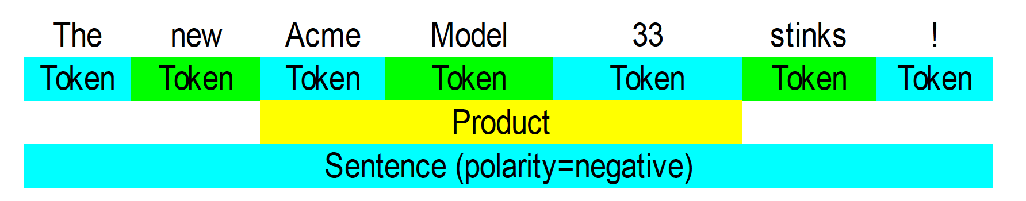
Instances
Cases that can be learned
Every instance is mapped to an output variable

Slide 10
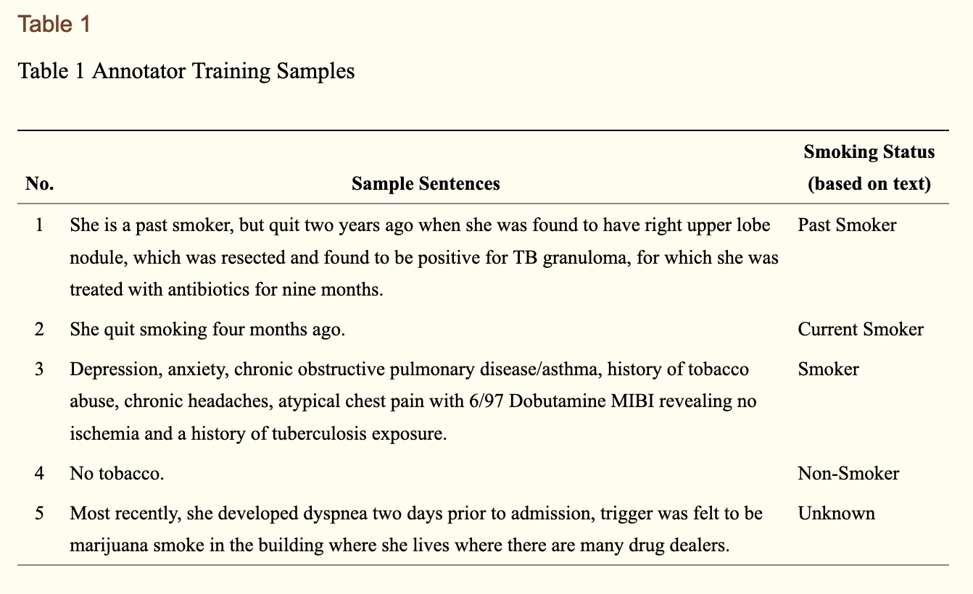
Instances
Cases that can be learned
Every instance is mapped to an output variable
Uzuner O, Goldstein I, Luo Y, Kohane I. Identifying patient smoking status from medical discharge records.
J Am Med Inform Assoc. 2008;15(1):14–24. doi:10.1197/jamia.M2408

Slide 11
Attributes/features
Pieces of information about an instance

Slide 12
Attributes/features
Pieces of information about an instance

Slide 13
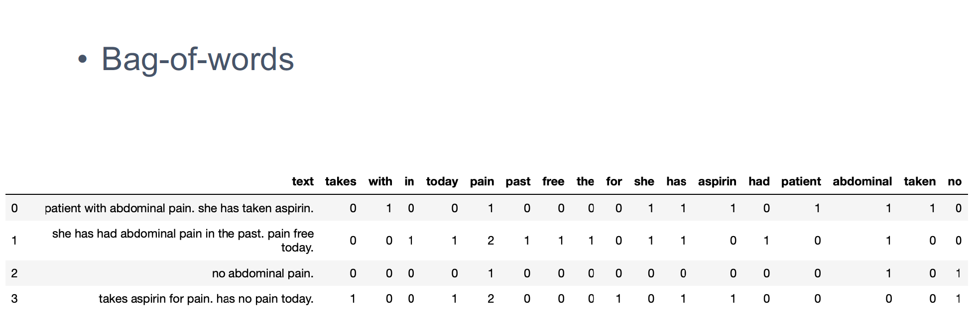
Attributes/features - representations

Slide 14
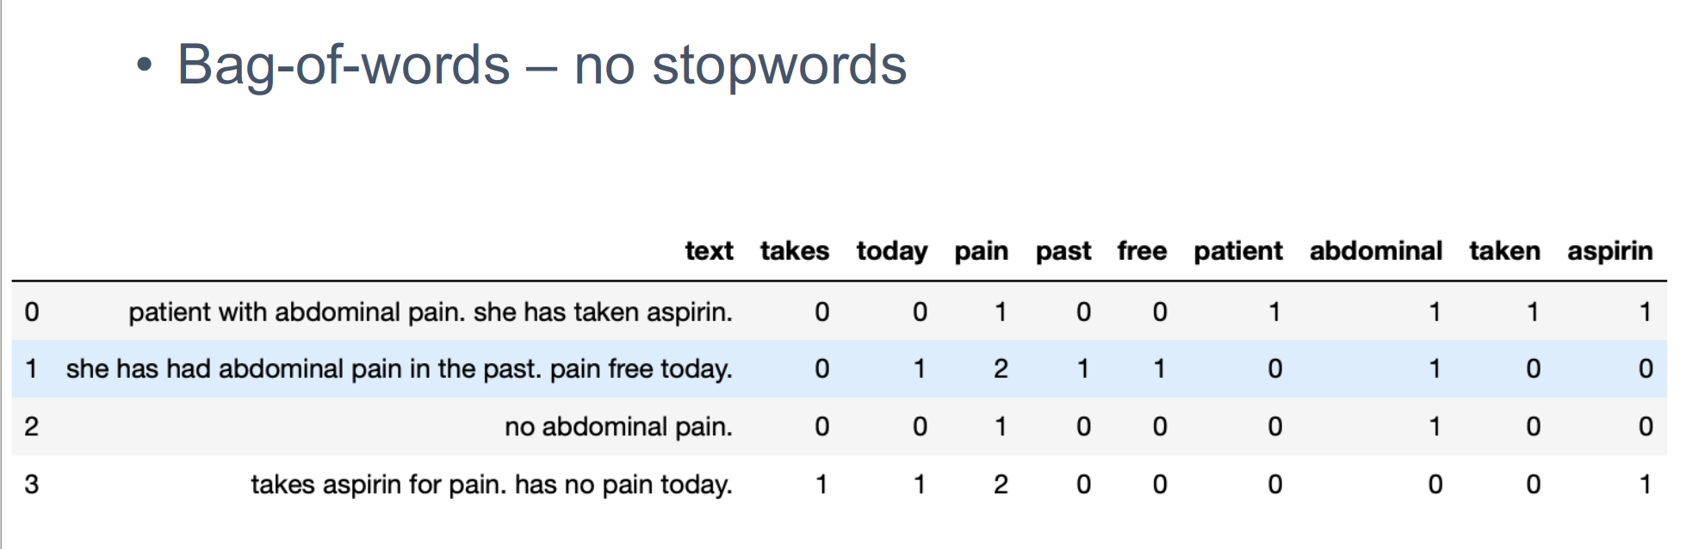
Attributes/features - representations

Slide 15
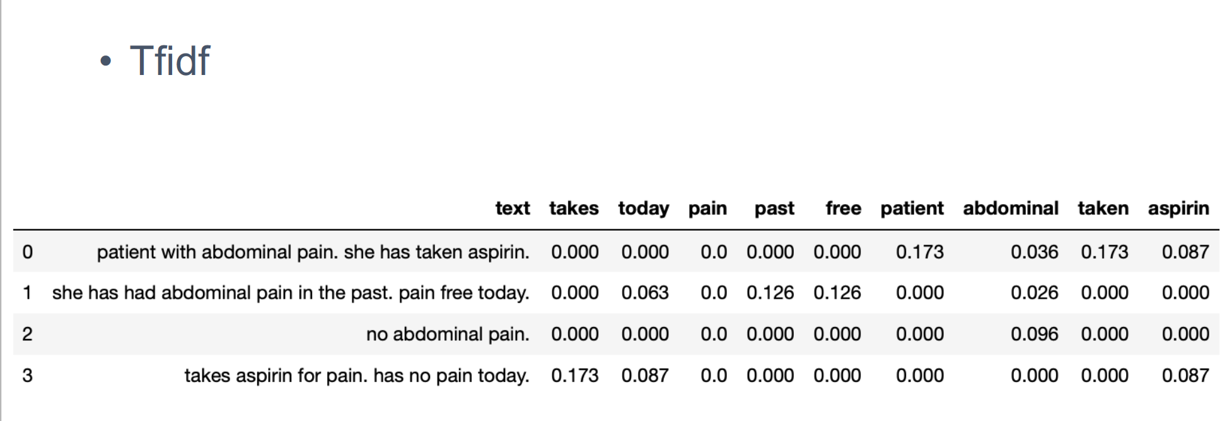
Attributes/features - representations

Slide 16
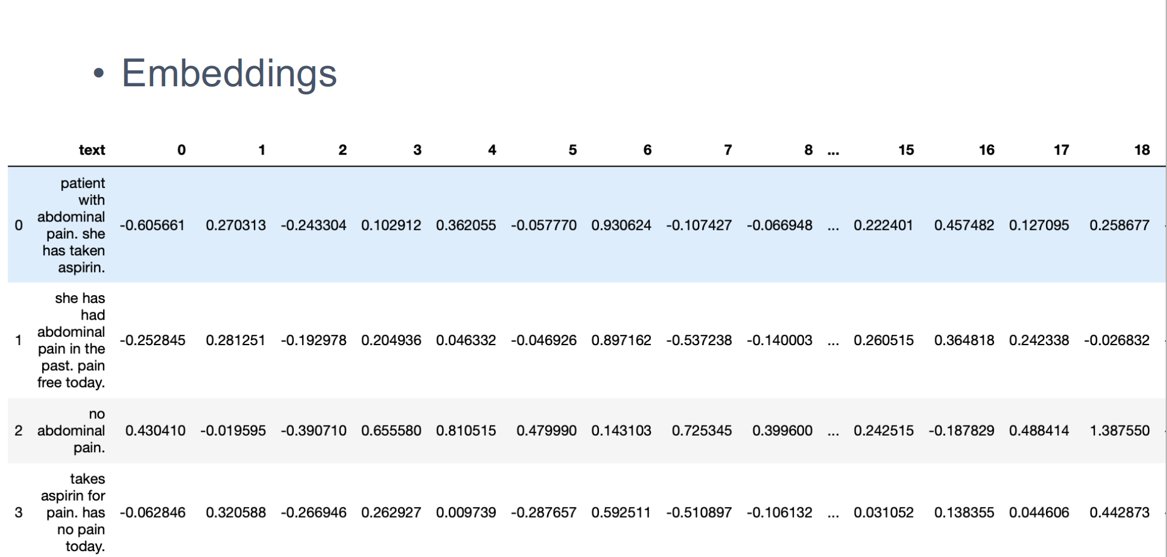
Attributes/features - representations

Slide 17
Classes/labels
The output variable we want to learn

Slide 18
Classes/labels
The output variable we want to learn

Slide 19
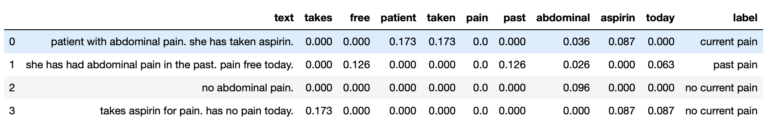
Classes/labels
The output variable we want to learn

Slide 20
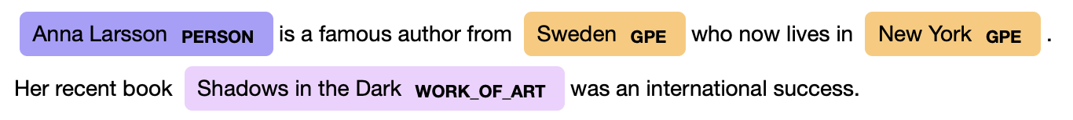
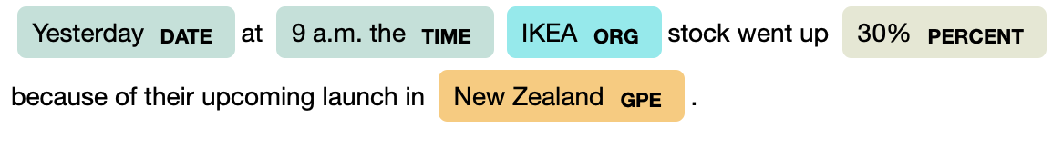
Sequence learning tasks in NLP

Slide 21
Sequence learning tasks in NLP
What are the instances?

Slide 22
Representation - IOB
TEXT | IOB | ENTITY TYPE | DESCRIPTION
Anna | B | PERSON | beginning of an entity
Larsson | I | PERSON | inside an entity
is | O | "" | outside an entity
a | O | "" | outside an entity
famous | O | "" | outside an entity
author | O | "" | outside an entity
from | O | "" | outside an entity
Sweden | B | GPE | beginning of an entity

Slide 23
Representation - BILOU
TEXT | IOB | ENTITY TYPE | DESCRIPTION
Anna | B | PERSON | beginning of an entity
Larsson | L | PERSON | last of an entity
is | O | "" | outside an entity
a | O | "" | outside an entity
famous | O | "" | outside an entity
author | O | "" | outside an entity
from | O | "" | outside an entity
Sweden | U | GPE | unit entity

Slide 24
Classification tasks in NLP
Common ‘old-school’ algorithms:
Support Vector Machines
Naive Bayes
Random Forest
Conditional Random Fields (sequence learning)
Hidden Markov Models (sequence learning)
CNN, RNN
Transformer models

